Slide 1
Hackathon’25 : Solve Rubik’s Cube
Name : Rhea Dmello

Slide 2
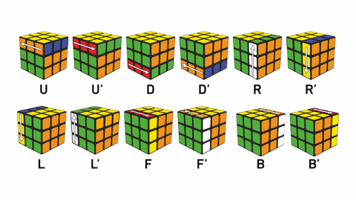
Solve Rubik’s Cube
Overview
Participants are challenged to design and implement an algorithm that can solve a standard 3x3 Rubik’s Cube from any scrambled state. The solution must mimic the real-world logic of solving a cube through a sequence of valid moves.
What We’re Looking For : 🔍
Problem-Solving Approach
How do you break down the problem?
How do you model the cube’s state and transitions?
Use of Data Structures
How do you represent the cube internally (e.g., arrays, trees, graphs)?
Use of efficient structures to track states and operations.
State Prediction Logic
Ability to track and predict cube state after each move.
Design of a move engine to simulate rotations and track permutations.
Algorithm Efficiency
How fast can your solution reach the solved state?
Complexity (time and space) of your algorithm.
Bonus Evaluation Areas
Creativity in solution design.
Visual simulation or cube UI (optional but Wow factor).
Scalability for different cube sizes (2x2, 4x4, etc.) : Optional
Deliverables:
Working algorithm (code)
Brief walkthrough/presentation of your approach
Output example(s) from your solver
It’s Not Just a Puzzle - It’s a Test of Mind, Math, and Moves!

Slide 3
Problem understanding
Simulates a real 3x3 cube digitally
Accepts any scramble sequence
Find the shortest possible solution using only valid moves
Demonstrate correctness and efficiency

Slide 4
The approach
The approach includes 4 steps:
Simulate the Cube: Accurate digital twin with all 12 valid moves.
Solve Efficiently: Smart search with pruning and heuristics.
Verify Solutions: Test every solution to ensure correctness.
Interactive Demo: Real-time visualization with Pygame.
Scramble → Solve → Verify → Visualize

Slide 5
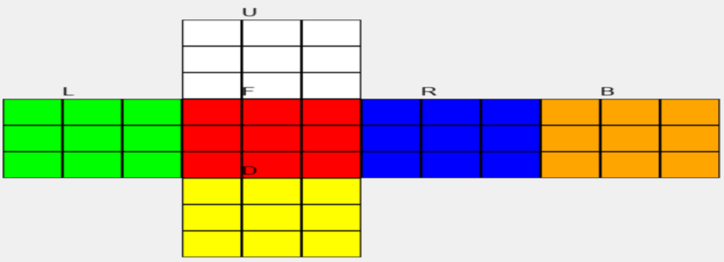
Cube representation
Dictionary-based structure for clarity and ease of access.
6 faces: U (Up), D (Down), L (Left), R (Right), F (Front), B (Back)
Each face is a 3x3 grid, representing stickers accurately
Colors: W (White), Y (Yellow), R (Red), O (Orange), G (Green), B (Blue)

Slide 6
State Prediction Logic
State Prediction Logic: Ability to track and predict cube state after each move.
Every move updates both the face and adjacent edges.
Ensures physical accuracy without shortcuts.

Slide 7
Algorithm Efficiency
1. It Tries Shallow First
First, it tries to solve in 1 move - fails?
Then tries 2 moves - still fails?
Keeps going until it finds a solution - This is called Iterative Deepening

Slide 8
Algorithm Efficiency
2. It Estimates How Far It Is
Counts how many stickers are in the wrong place
Divides by 8 - because one move usually fixes ~ 8 stickers
If current depth + estimate > limit - skip this path - This is the heuristic - like a “gut feeling”

Slide 9
Algorithm Efficiency
3. It Avoids Dumb Moves
Won’t do U right after U' (undoes itself)
Won’t do R twice in a row (wasteful)
-This prunes bad paths early
Result: Finds the shortest solution - fast.

Slide 10
Results
Test case | scramble | Solution moves | Solved
1 | F,R | R', F' | YES
2 | U, R, F', L | L', F, R', U' | YES
3 | 6 random moves | 6 moves | YES
4 | 8 random moves | 7 moves | YES

Slide 11
Interactive Demo
Visual simulation or cube UI
Real-time step-by-step solving.
Features:
Press 1–4 to pick a test case
Press S to scramble the cube
Press SPACE to apply one move at a time
See the cube change live

Slide 12
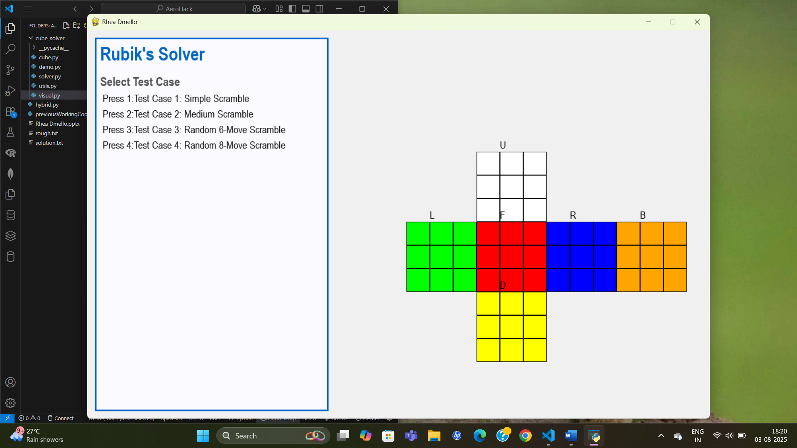
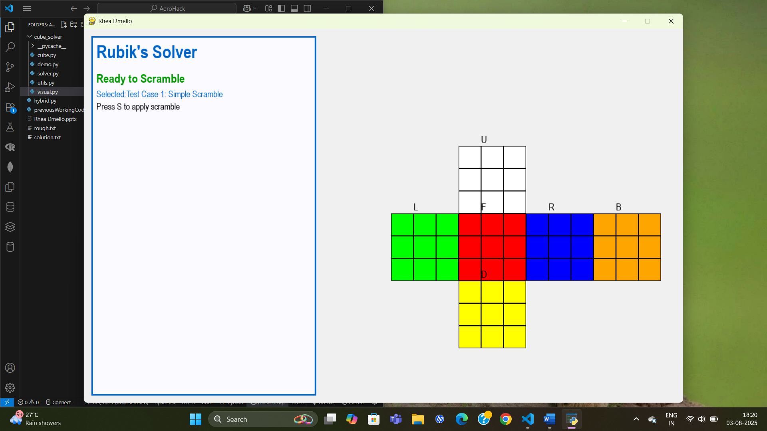
Interactive Demo
Step 1
Step 2

Slide 13
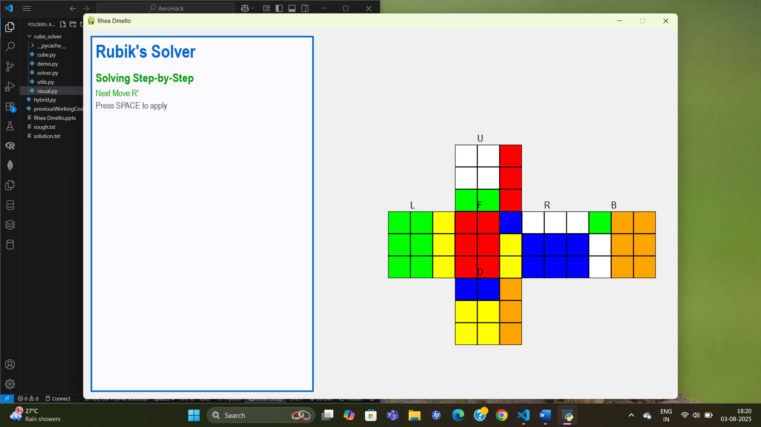
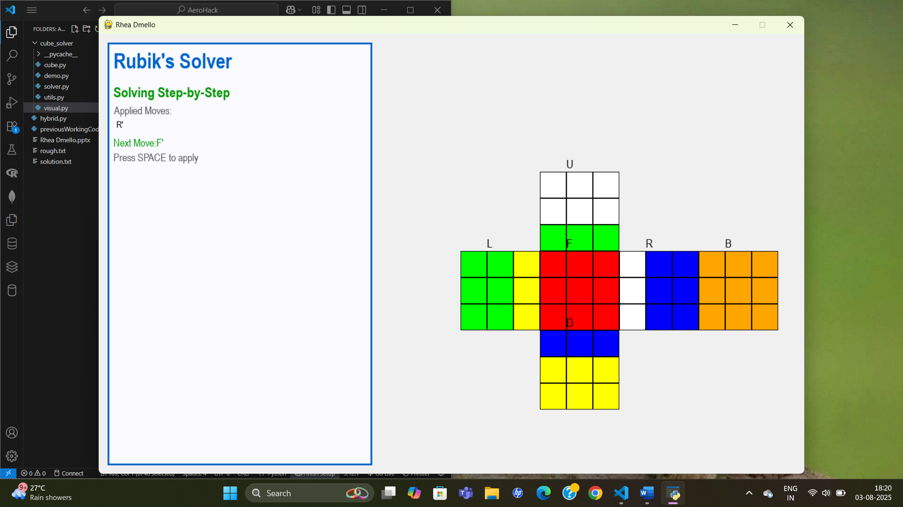
Interactive Demo
Step 3
Step 4

Slide 14
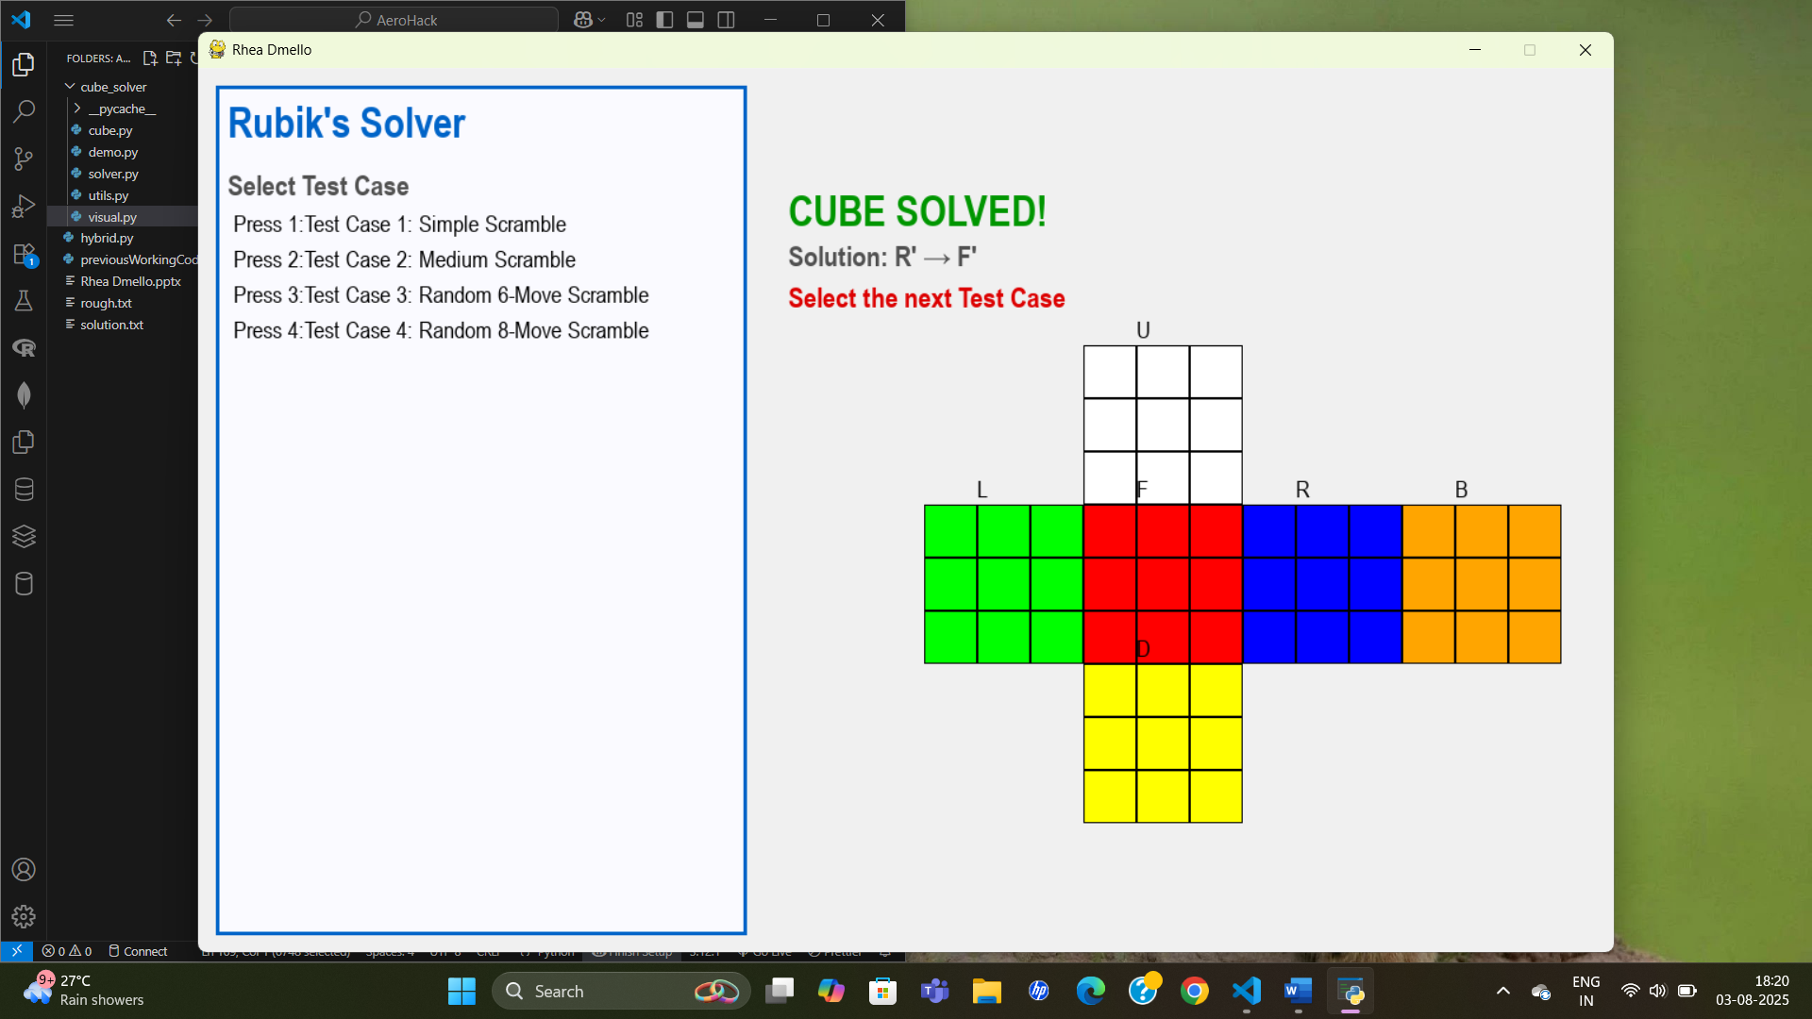
Interactive Demo
Step 5

Slide 15
THANK YOU

